Slide 1
Quizmine Mobile Applications
App Name: Quizmine Math 2.0
Target Platform: Windows Mobile, iPhone & Android Platform
Vikramaditya Jakkula

Slide 2
Quizmine Math 2.0
Mathematics application
Offers the following:
Addition Subtraction Multiplication Division fractions exponents percents Rounding money and time | estimation Commission Discount Sales Tax Price with Sales Tax Shipping Simple Interest Estimating Tips

Slide 3
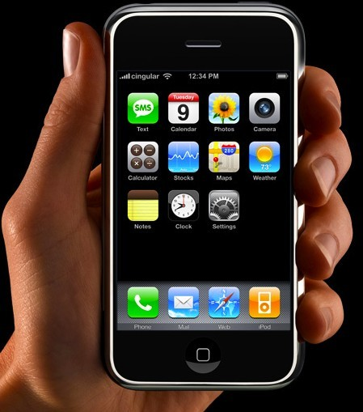

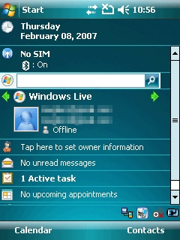
Architecture: Mobile to Cloud
Webpage
Http Post
Mobile User table
Quizmine DB
Quizmine Math 2.0

Slide 4
User Migration: From Mobile to Cloud
User Data is pushed to DB
Along with a Unique GUID
[User Name, Email, GUID]
User enters profile in mobile
Separate Mobile User Registration Page on Website
[We can identify the user by his Guid]
[User Password]
Registration complete
[Migration complete]

Slide 5
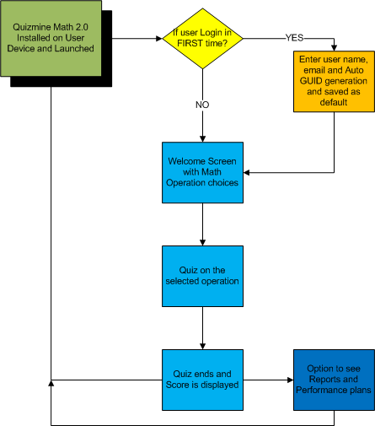
Workflow for App

Slide 6
Features
User Profile with Push to cloud ability
Rich user interface (Glossy)
Speech option to read questions
User Setting tab [No of questions, voice on/off, Music on/off, levels (Easy, Medium, Hard), Digit(1,2,3)]
Reports with performance tracking
Formula reference sheet
Learning plan & tracking

Slide 7
Timelines (Ship to store)
Release: December 14, 2009
Quizmine Math 2.0
for Android
M1
Release: December 28, 2009
Quizmine Math 2.0
for iPhone
M2
Release: January 14, 2010
Quizmine Math 2.0
for Windows
M3
Nov
Dec
Jan
Feb
Mar
Apr

Slide 8
Resources
Dev Resource: Ashish Patel
PM: Vikramaditya J

Slide 9


